Slide 1
Final Demo Presentation
Jobify
Github Repository: https://github.com/JonTimus/CSE_5324_Project
Project Walkthrough Demo Link: https://drive.google.com/file/d/1olXBeP3y_n-OP_mwYw5sFixl4yJuRFVQ/view?usp=sharing

Slide 2

List of Requirements
1. Programming Tutorials
2. Providing Quizzes
3. CV Generator
4. Programming Articles

Slide 3
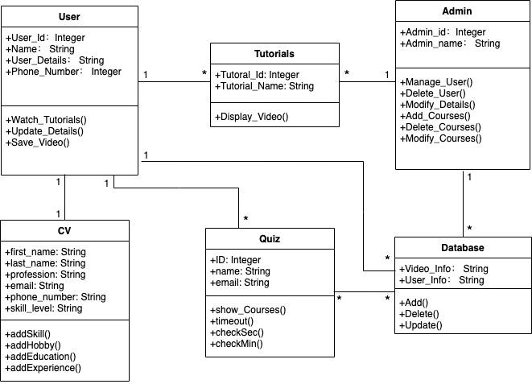
UML Diagrams: 1. Class Diagram

Slide 4
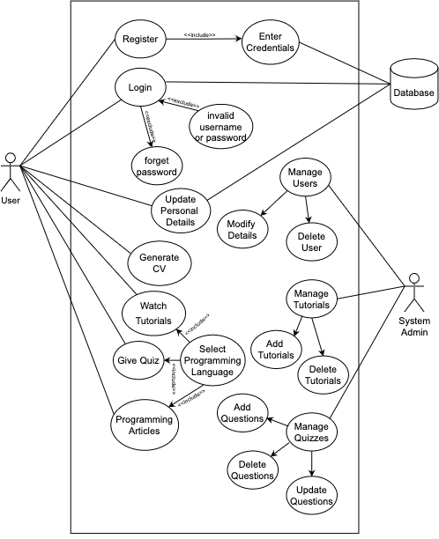
UML Diagram:
2. Use Case Diagram

